Slide 1
Gold Price Prediction Machine Learning
Done By – Diya.P

Slide 2
Importance of Predicting Gold Prices: Gold prices play a pivotal role in the global economy, serving as a barometer for economic stability and a safe-haven asset during times of uncertainty. Investors, financial institutions, and governments closely monitor gold prices for strategic decision-making. Predicting gold prices accurately can provide valuable insights for investment strategies, risk management, and economic forecasting.
Problem Statement: The challenge lies in the inherent complexity of the gold market, which is influenced by a myriad of factors such as geopolitical events, economic indicators, and market sentiment. The goal is to design a predictive model capable of capturing the intricate relationships within these variables to generate accurate and timely forecasts. Addressing this problem is crucial for investors and policymakers seeking to navigate the dynamic nature of the gold market and make informed decisions amid economic uncertainties.

Slide 3
Objective of the Project: The primary objective of this project is to develop a machine learning model that can effectively predict gold prices based on historical data. By leveraging advanced algorithms, the goal is to enhance our understanding of the factors influencing gold prices and provide stakeholders with reliable forecasts. Ultimately, the project aims to contribute to informed decision-making in financial markets and economic planning.

Slide 4
The choice of machine learning models for predicting gold prices depends on various factors, including the nature of your data, the complexity of relationships, and the computational resources available. There are various machine learning models we can experiment with such as:-
Linear Regression:
Simple and interpretable.
Assumes a linear relationship between features and gold prices.
Decision Trees:
Can capture non-linear relationships and interactions.
Prone to overfitting, so consider using ensemble methods.
Random Forest:
Ensemble of decision trees that helps mitigate overfitting.
Provides feature importance insights.
Gradient Boosting Models (e.g., XGBoost, LightGBM):
Powerful ensemble models that sequentially improve on weaknesses.
Efficiently handle complex relationships in data.
Support Vector Machines (SVM):
Effective for capturing non-linear relationships.
May require careful tuning of hyperparameters.
Neural Networks (Deep Learning):
Can handle complex relationships and patterns.
Requires a larger amount of data and computational resources.
K-Nearest Neighbors (KNN):
Non-parametric method suitable for capturing localized patterns.
Sensitive to the choice of distance metric.
Time Series Analysis with Exponential Smoothing (ETS):
Suitable for capturing trends and seasonality in time series data.
Provides methods like Holt-Winters for forecasting.

Slide 5
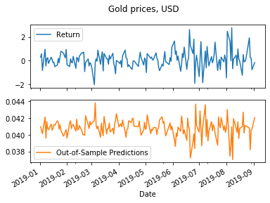
The models I have implemented are :
1. Linear Regression Model
For this task, I have used the Linear Regression algorithm.
The output I have obtained from this is :-

Slide 6
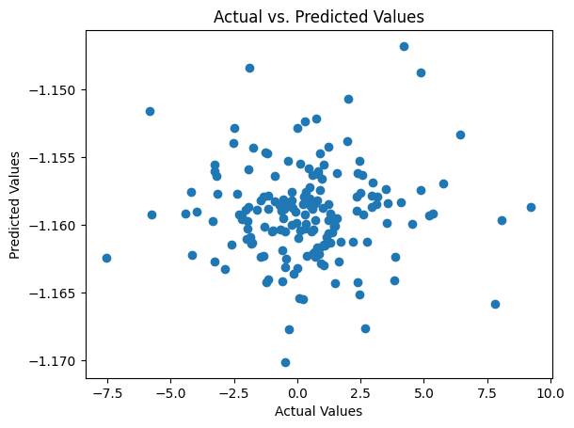
2. SVR :-
I have implemented SVR model also.
In the gold price prediction project, Support Vector Regression (SVR) was employed to capture non-linear relationships between selected features and gold prices. After cleaning and scaling the data, the SVR model, utilizing the Radial Basis Function (RBF) kernel, was trained on the dataset. Hyperparameter tuning, including optimizing the regularization parameter (C) and kernel-specific parameters, was performed. The model's performance was evaluated using regression metrics on the testing set, and results were visualized to communicate predictions against actual gold prices.

Slide 7
3. The third model I have implemented is Random Forest
The Random Forest model was applied to capture complex relationships in the dataset. After data cleaning and feature selection, the Random Forest algorithm, an ensemble of decision trees, was trained on the dataset. Hyperparameter tuning was conducted to optimize parameters such as the number of trees and maximum depth. The model's performance was evaluated using regression metrics on the testing set, and feature importance analysis was conducted to understand the variables influencing gold price predictions. Results were visualized to communicate the model's effectiveness in forecasting gold prices.

Slide 8
4. The 4th model is Decision Tree.
The Decision Tree model was employed to capture patterns and relationships within the dataset. After data cleaning and feature selection, a single Decision Tree was trained on the dataset. The model's structure was built based on feature splits to optimize predictive accuracy. Hyperparameter tuning, such as adjusting tree depth, was performed to avoid overfitting. The Decision Tree's performance was evaluated using regression metrics on the testing set, and insights into feature importance were gained for interpretation. Results were visualized to communicate the model's ability to predict gold prices.

Slide 9
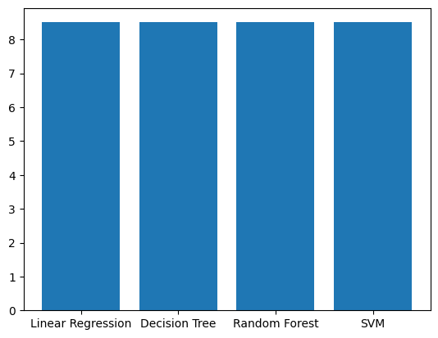
Final Bar Plot
The final bar plot showcasing the mse scores of all the models :-

Slide 10


